Slide 1
SmartStock Inventory Optimization for Retail Stores
Presented by: Guided By:
Bhakthi.S P Shakthi GopalaKrishnan

Slide 2
Project Goal and Objectives
Predict stock shortages and optimize inventory reload based on sales data.
Objectives:
  Monitor retail stock efficiently.
  Predict when items will go out of stock.
  Suggest when to reload stock based on sales trends.
  Minimize stock-outs and overstock.

Slide 3
Requirements
Requirement | Purpose
Python 3.x | Programming language for backend and data processing
Django | Web framework to build the dashboard / inventory app
MySQL Server + Workbench | Store and query retail inventory data
Python Libraries:
- pandas | Data manipulation and conversion
- datasets (Hugging Face) | Load the FreshRetailNet-50K dataset
- mysql-connector-python | Connect Python/Django to MySQL
- numpy | Efficient numerical operations
- matplotlib / seaborn (optional) | Data visualization for analysis and reporting
- Django REST Framework (optional) | For API endpoints if needed

Slide 4
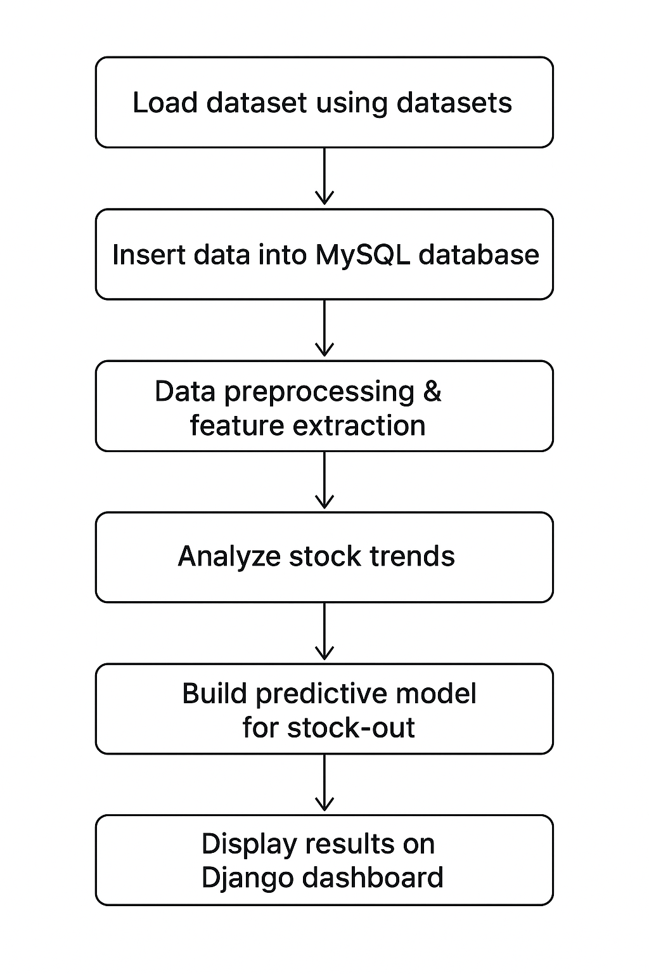
System flow:
Load dataset using datasets.
Insert data into MySQL database.
Data preprocessing & feature extraction.
Analyze stock trends Build predictive model for stock-out.
Display results on Django dashboard.

Slide 5
Dataset
FreshRetailNet-50K dataset from Hugging Face.
Train split: 4.5 million rows.
Eval split:350k rows
Columns include: city_id, store_id, management_group_id ,first_category_id, second_category_id, third_category_id , product_id, dt, sale_amount * hours_sale, stock_hour6_22_cnt, discount, holiday_flag, etc.
Why used: Realistic sales & inventory dataset to simulate stock prediction.

Slide 6
Steps Completed
Loaded FreshRetailNet-50K dataset using datasets.
Connected Python to MySQL (mysql.connector).
Created table fresh_retail in schema retail_inventory_db.
Inserted train and eval splits in chunks of 10,000 rows.
Dataset ready for analysis and predictive modeling.

Slide 7
Challenges & Solutions
Challenge Large dataset (4.5M rows) Windows symlink warnings MySQL connection errors | Solution Inserted in chunks to avoid memory issues. Safe to ignore; caching works . Verified username, password, host.

Slide 8
Next Steps
1.Data Analysis:
  Identify products at risk of going out of stock.
  Track sales trends per store/product.
  Evaluate effect of promotions, discounts, holidays.
2. Data Preprocessing:
  Feature extraction (e.g., average daily sales, stock levels) .
  Handle missing or inconsistent data.
3. Predictive Modeling:
  Predict stock-out events .
  Suggest optimal stock reload times .
4. Visualization / Reporting:
  Dashboards showing stock alerts.
  Summary reports for managers.

Slide 9
Conclusion
Successfully loaded and stored retail sales and inventory data.
Dataset ready for stock-out prediction and optimization.
Next: analyze trends and build AI models.

